Slide 1
Predicting Home Runs Using Statcast Data

Slide 2
Project Overview
Objective:
Develop a model to predict whether a batter will hit a home run using statcast data
Challenges:
Data preparation, scraping, and cleaning
Working with large data
Prioritizing relevant predictors
Feature generation
Accomplishments:
Utilized custom functions to scrape, clean, and prepare statcast data
Created a xgboost model to predict home run probability

Slide 3
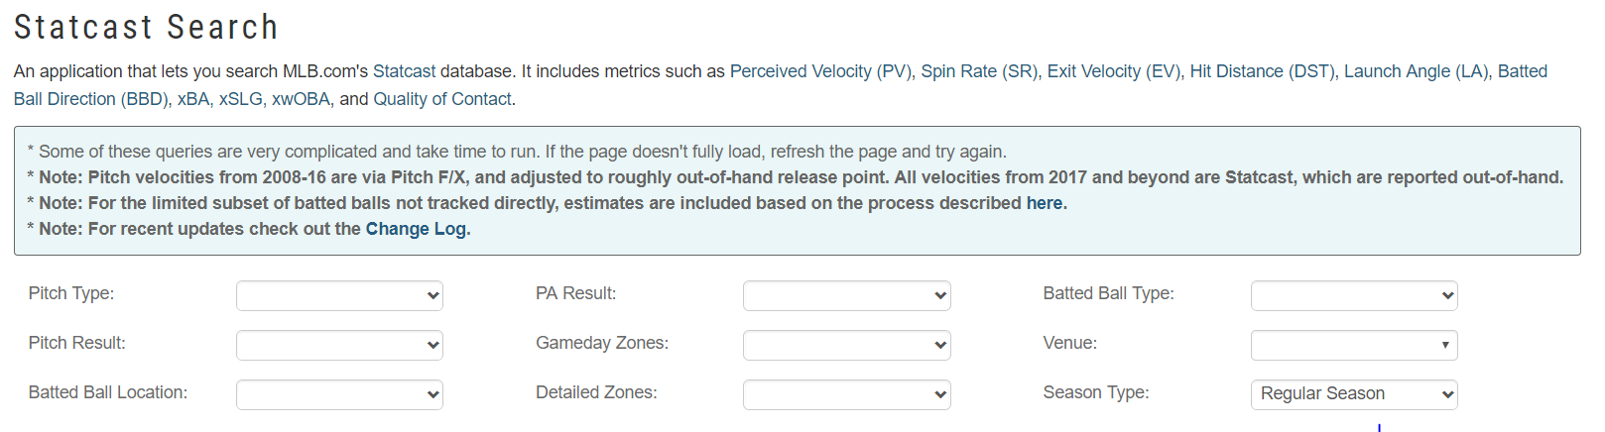
Data Preparation and Cleaning
Statcast
Introduced in 2015, Statcast is a high speed, automated tool used to analyze baseball player movements, batted balls, and pitches
The data is collected and published by Major League Baseball Advanced Media (MLBAM), and made available to fans via a graphical user interface at baseballsavant.com:

Slide 4
Feature Generation and Prioritization of Predictors (cont’d)
Batted Ball Metrics
Rolling averages of launch angles, exit velocities, and hit distances were calculated for each hitter using a window of 2400 pitches.
Then, we applied 0/1 indicators for different batted ball types (doubles, triples, homeruns, strikeouts, etc.) and calculated league averages for these feature.
Plate Discipline Metrics
These included metrics related to the percentage of strikes that a batter swung at, the percentage of balls that a batter swung at, and then the results of each swing (e.g. swinging strike, or contact).
Opponent Pitcher Metrics
Metrics were calculated to assess the quality of the pitcher a batter was facing.
These included the rates at which a pitcher allowed a ball to be hit in play, hit for a home run, hit in the air or on the ground.

Slide 5
Data Preparation and Cleaning (cont’d)
Challenge:
To perform analysis and modeling, a large dataset spanning multiple years and covering as many batted ball events as possible was needed
Approaches:
A web-scraper was used to obtain the data from the website and a custom lookup table was created to match batted ball events with player names and identifiers.
Due to the large size of the data set, dask – a library for parallel computing available in python – was used to convert data types for feature processing

Slide 6
Feature Generation and Prioritization of Predictors
Challenge:
The statcast tables are a rich dataset and contain a variety of information irrelevant to predicting home run probability, as well as information that might be helpful to a predictive model but not presented in a manner that’s easy for a model to interpret
Approaches:
Batted Ball Metrics
Plate Discipline Metrics
Opponent Pitcher Metrics

Slide 7
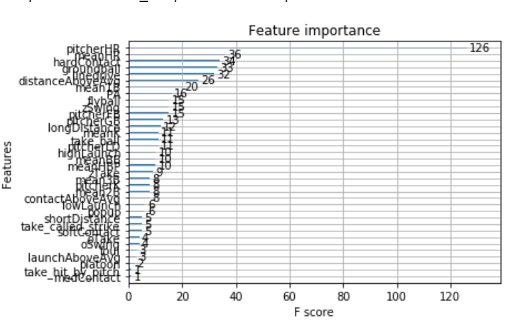
Results
Feature Importances
Our model identified pitcher home run allowed rate, league mean home run rate, and the batter’s hard contact percentage as the three most important features

Slide 8
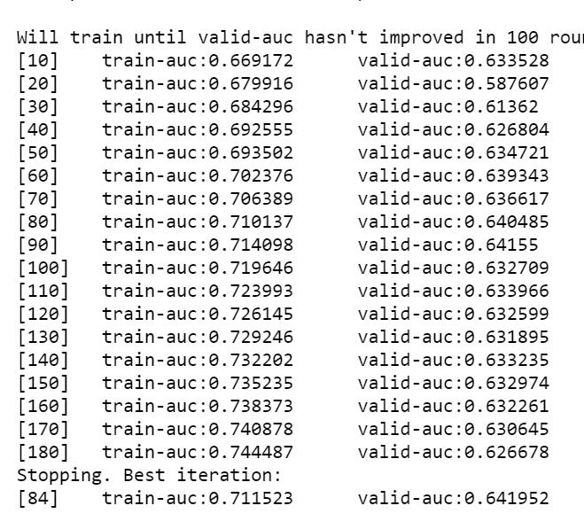
Results (cont’d)
Model Performance
Our model produced a valid auc of .64. This is fair performance, however our model would likely be improved by removing predictors and examining ensemble approaches

